Slide 1
COUNTERFEIT DASHBOARD
LUNCH & LEARN

Slide 2
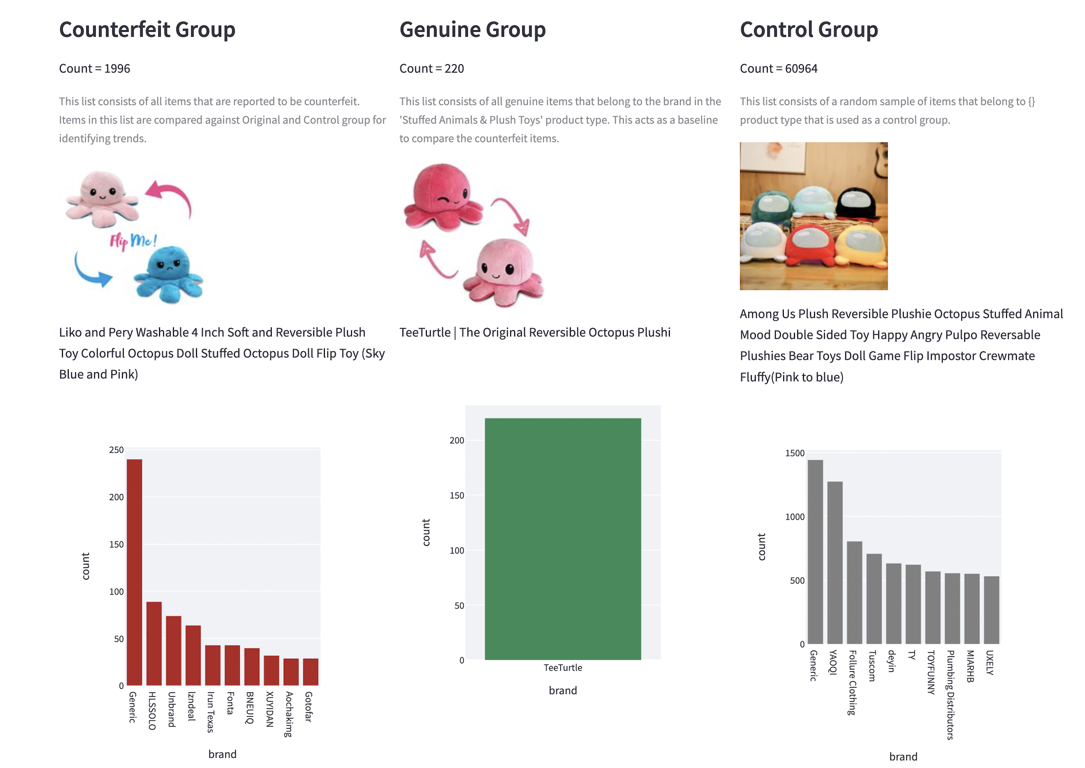
What Are Counterfeit Items? (And why we should care)
Counterfeit goods are intended to appear authentic but are fake.
Walmart would be liable for legal suits by sellers exasperated due to the impact on their business by counterfeit sales
Customers or Sellers can raise a counterfeit claim using the IP Web Form of Brand Portal - Any mention of details supporting why a product may be counterfeit and/or a test purchase placed will warrant a counterfeit investigation.

Slide 3
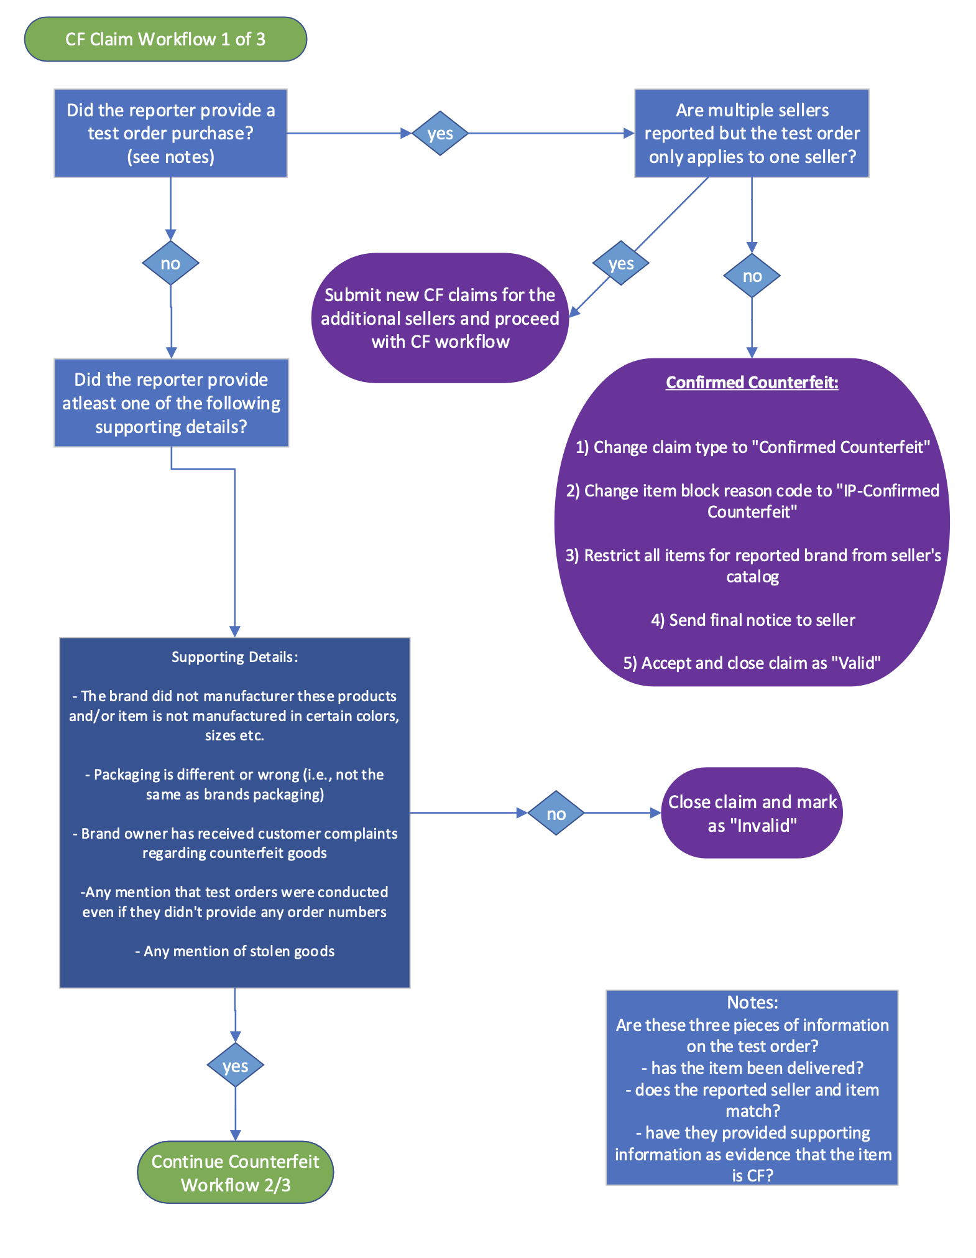
CF Claim Workflow

Slide 4
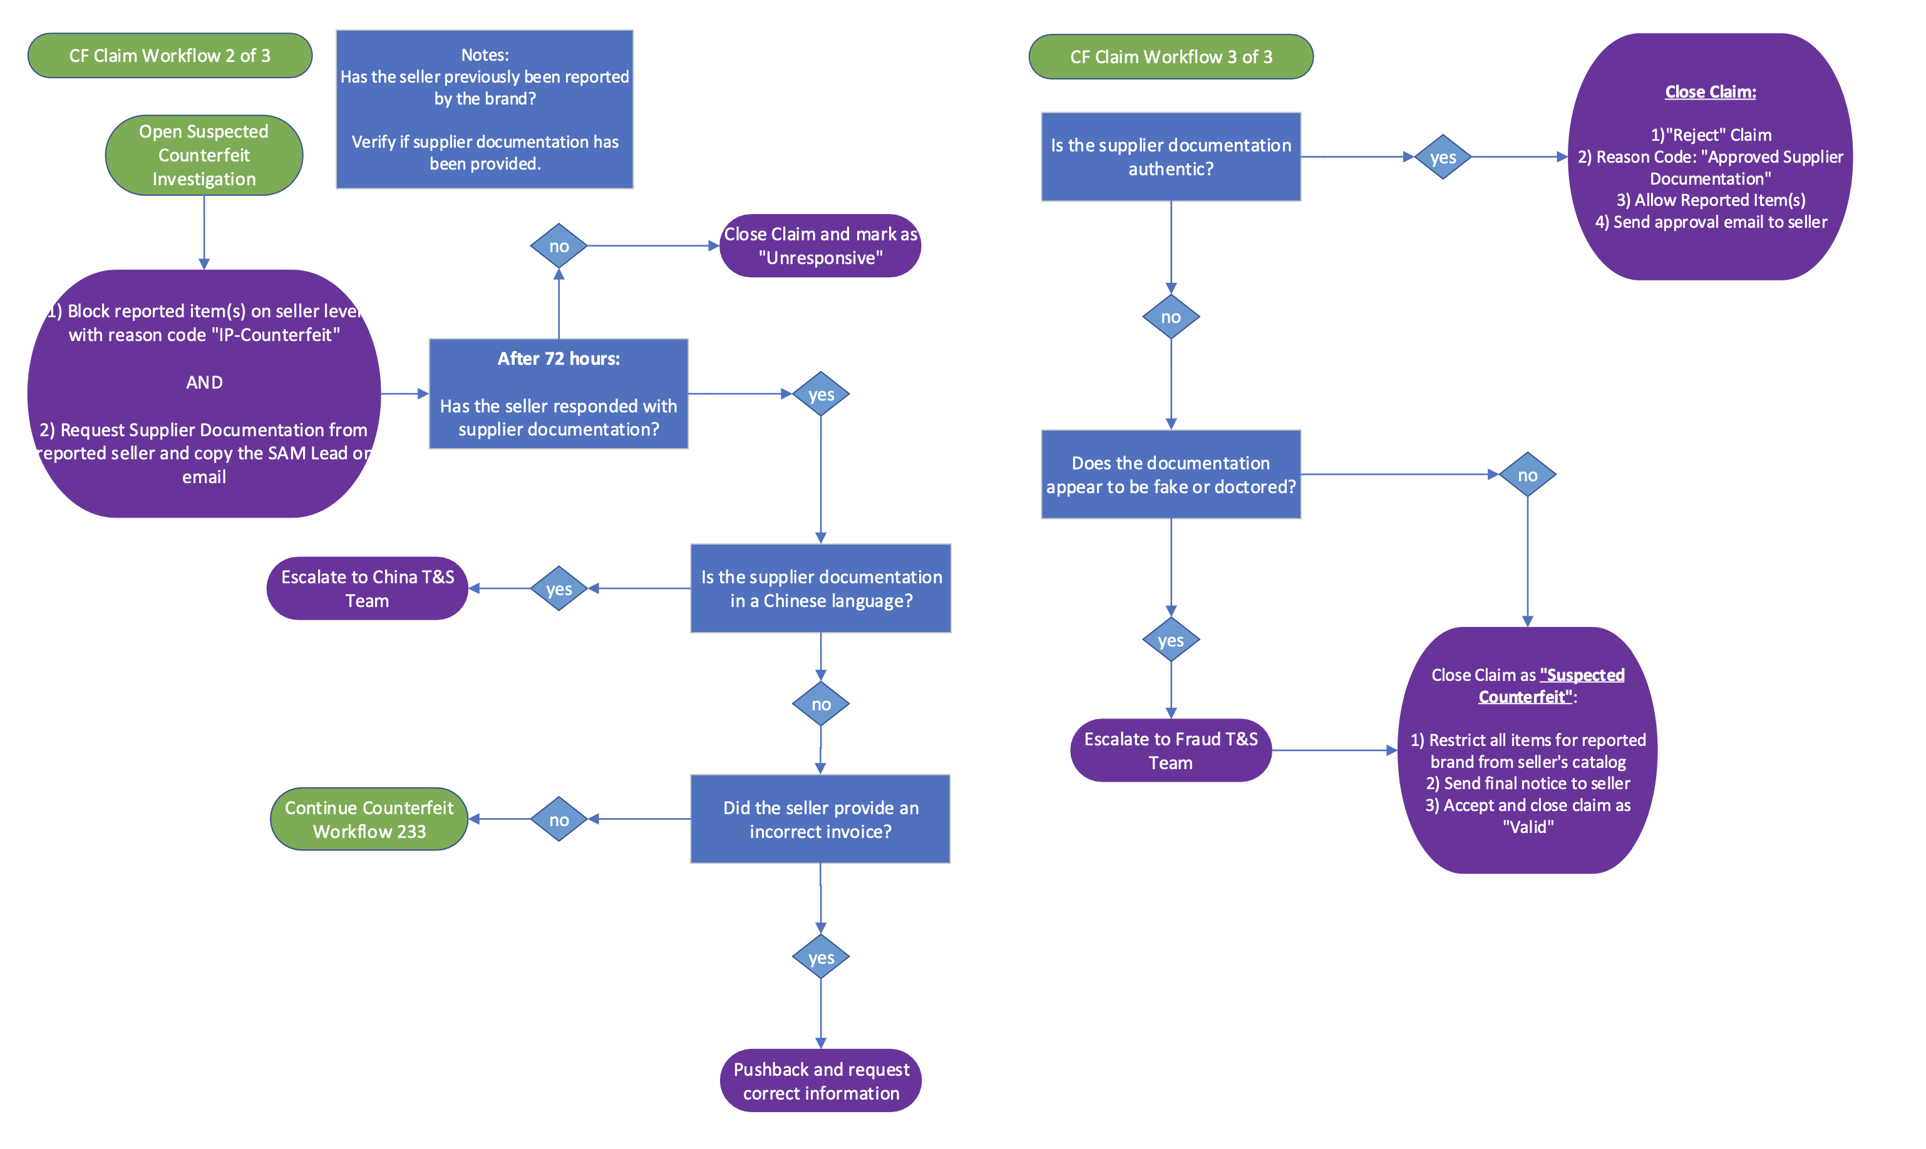
CF Claim Workflow (contd.)

Slide 5
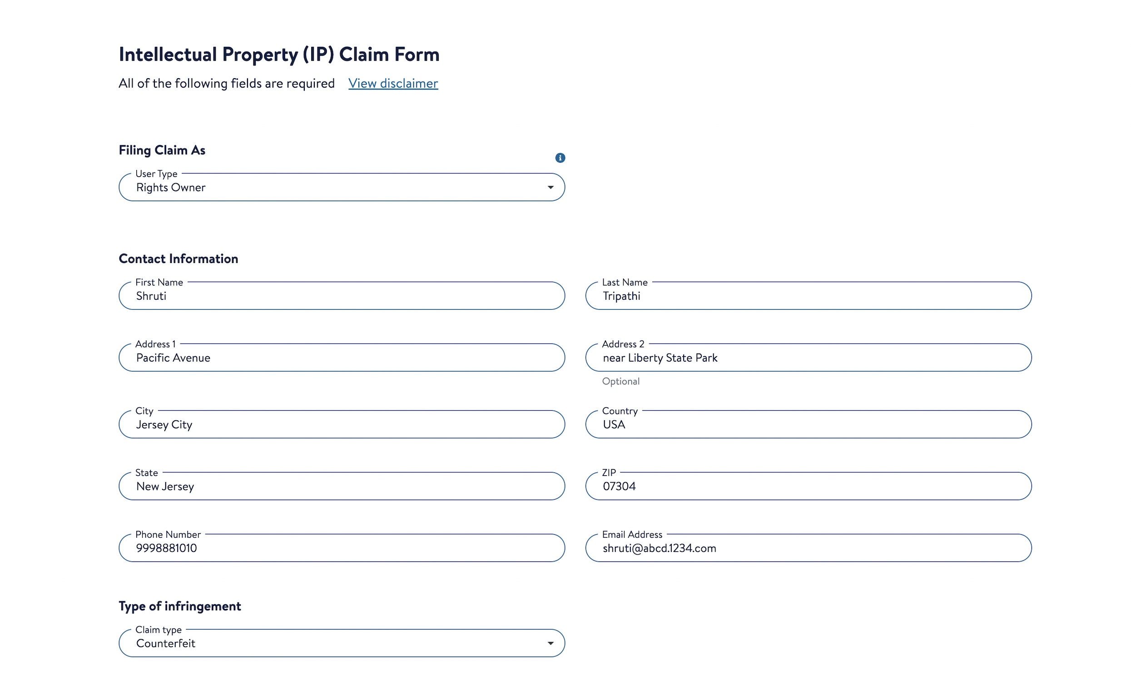
Submitting Counterfeit Claims
Rights owners can submit IP Claims via our IP Webform or they can register for the Brand Portal
Seller questions regarding what type of IP claim to submit can be directed to the Help Center.

Slide 6
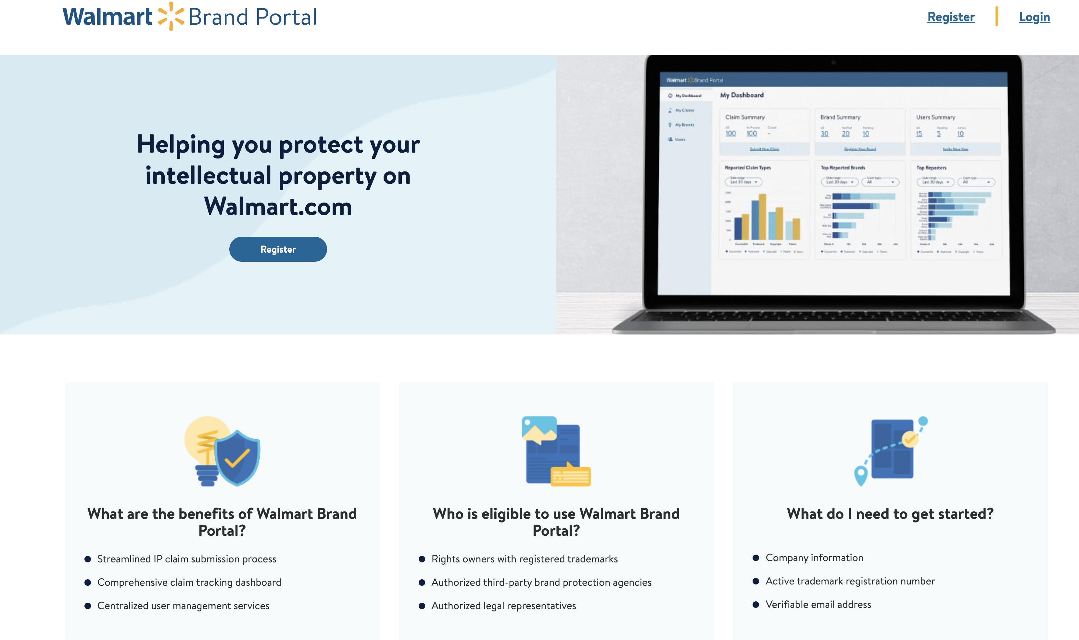
Submitting Counterfeit Claims

Slide 7
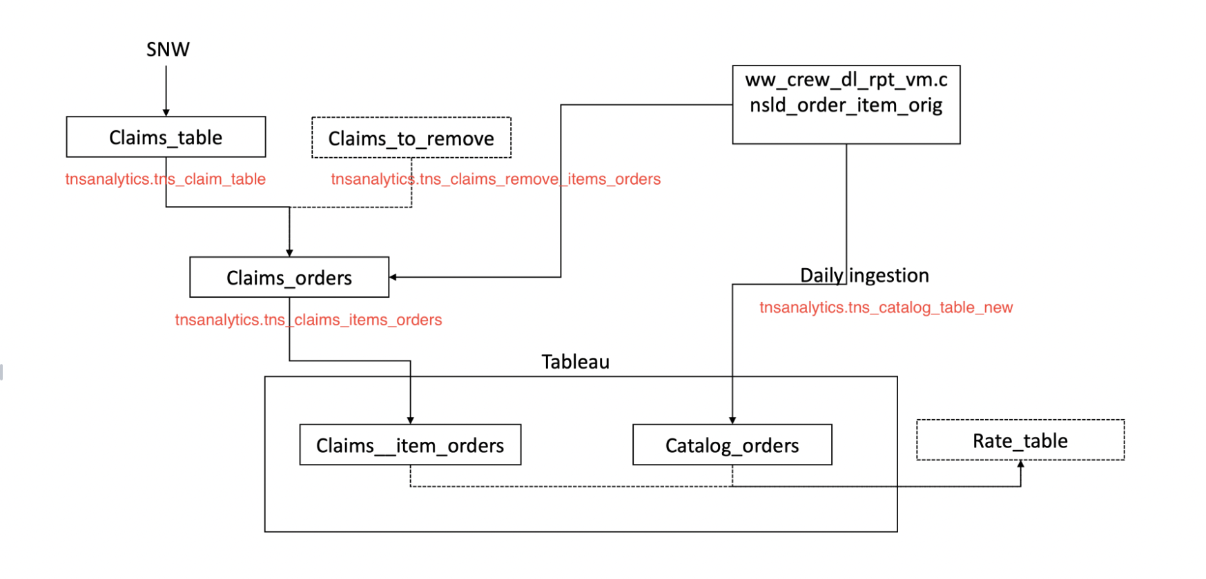
Counterfeit Rate (YTD) Data Flow
APPENDEX
https://confluence.walmart.com/pages/viewpage.action?spaceKey=BGECCOMP&title=Counterfeit+rate%28YTD%29+data+flow

Slide 8
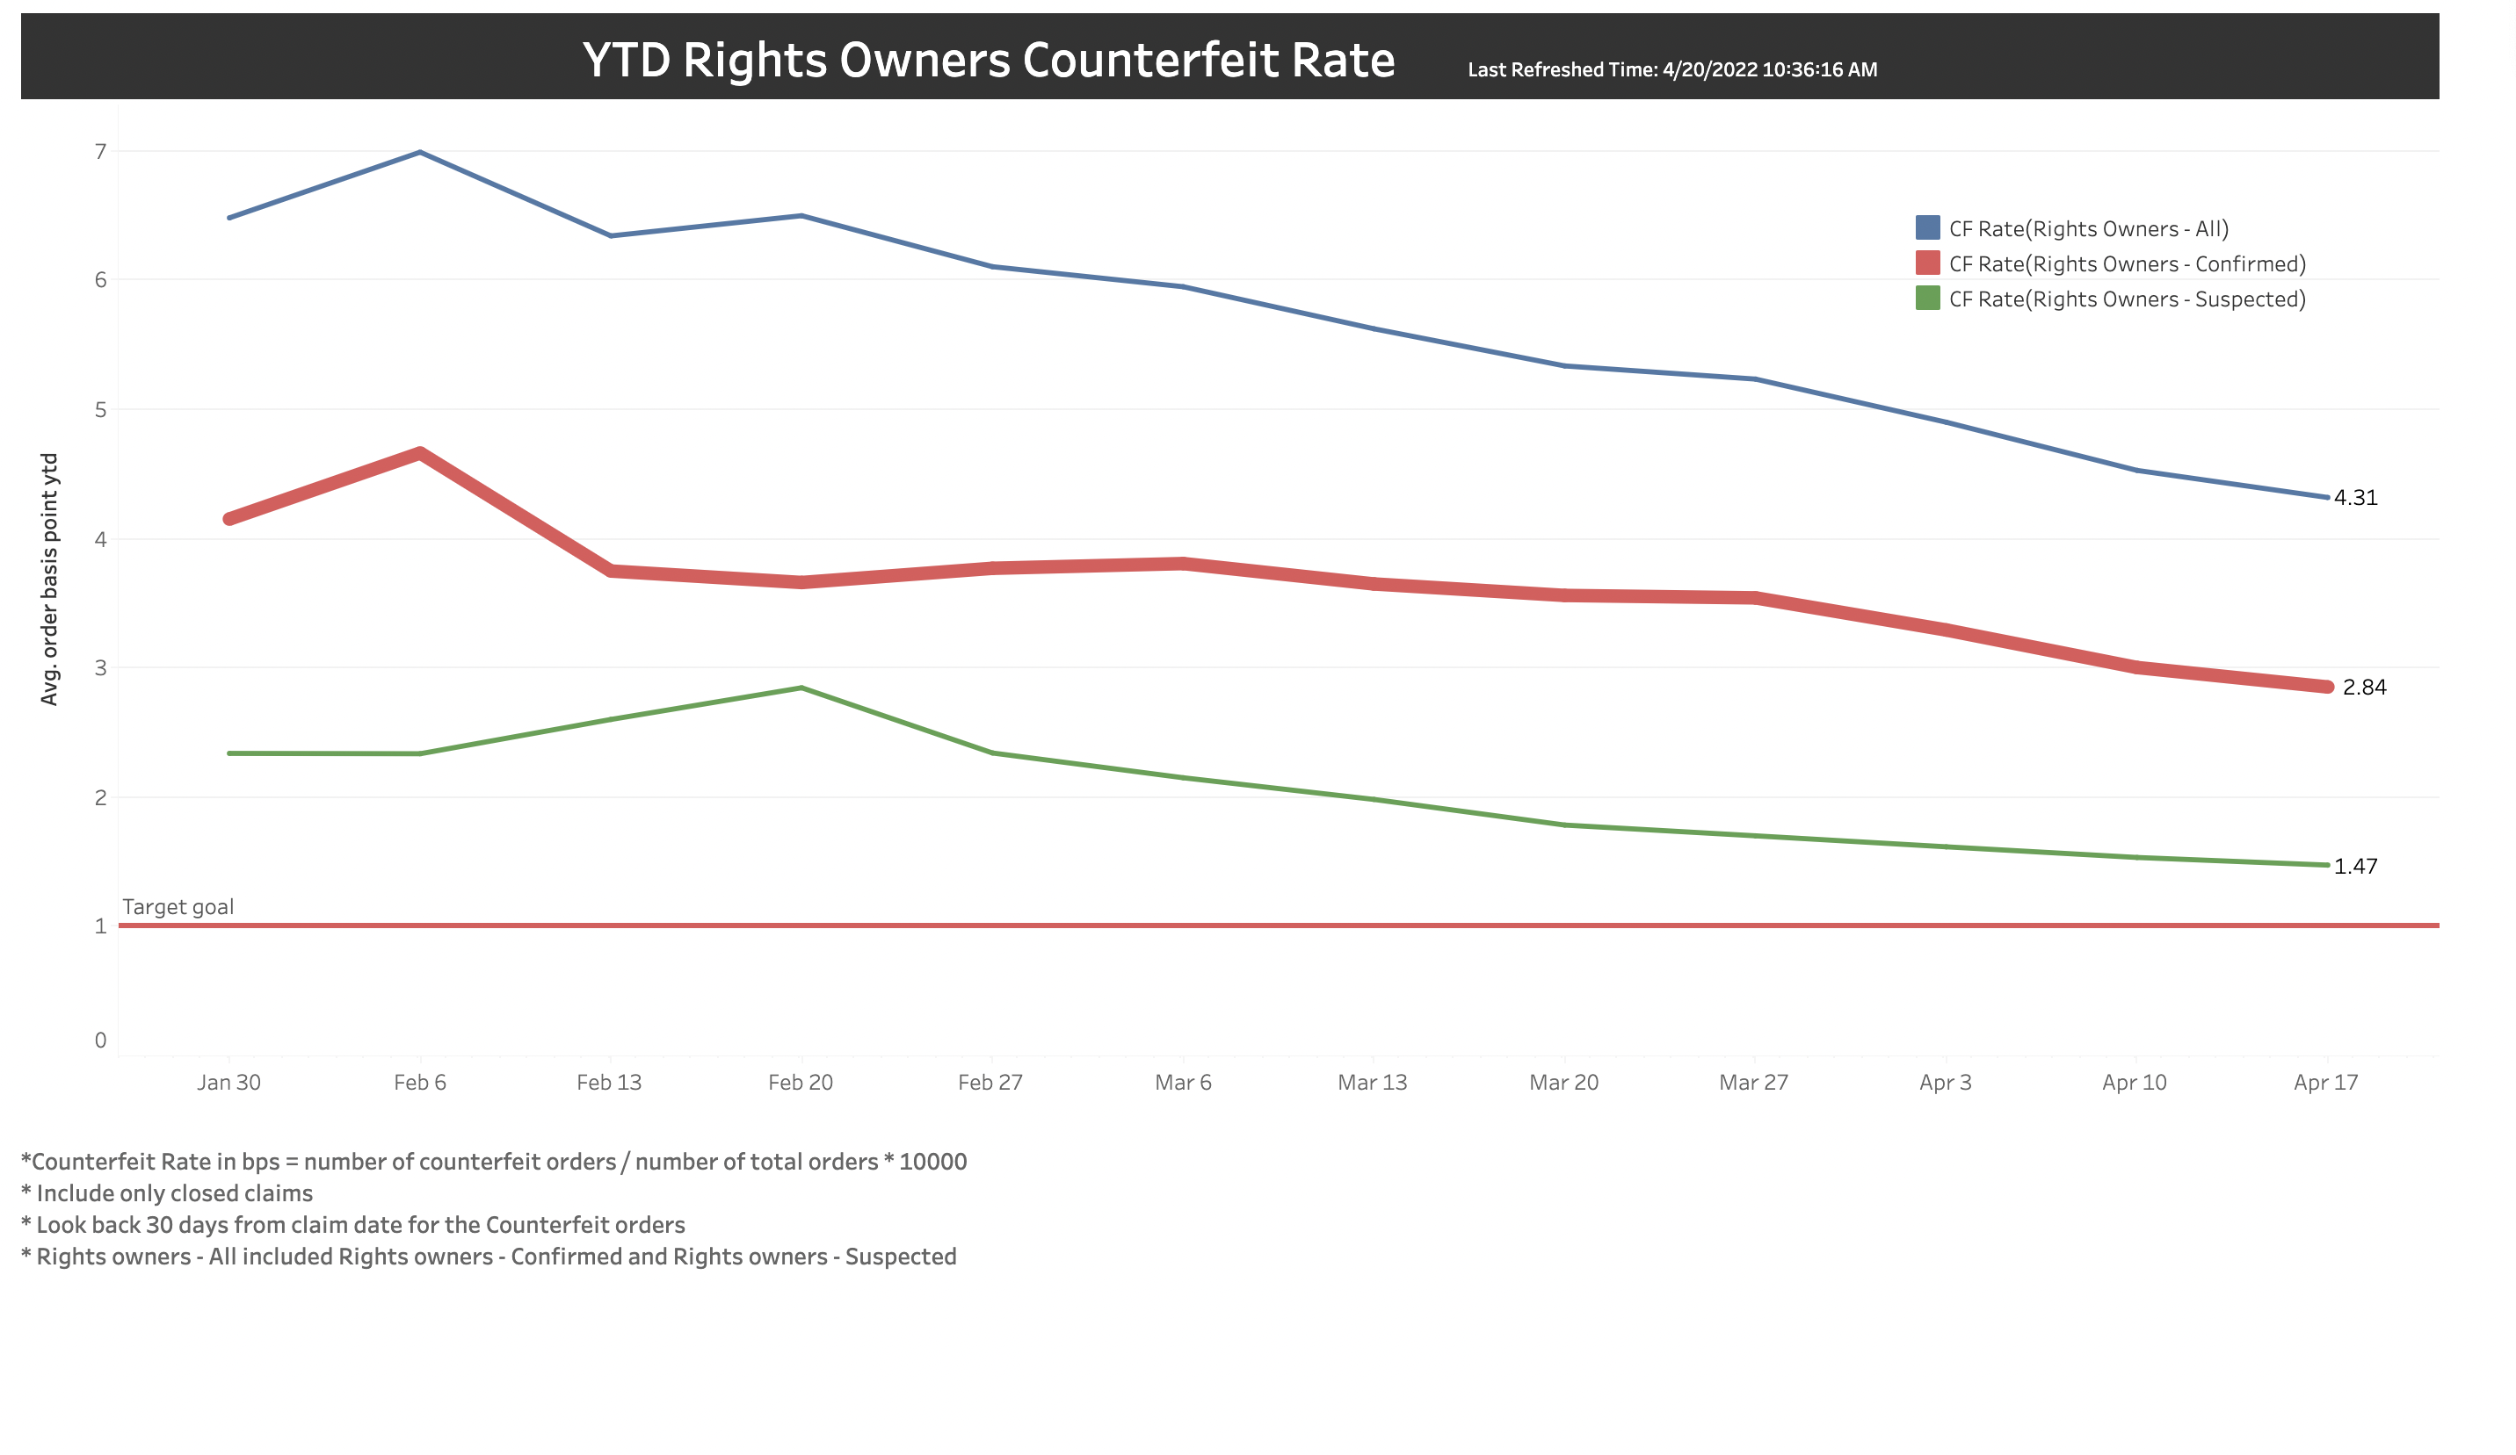
YTD Counterfeit Rate

Slide 9
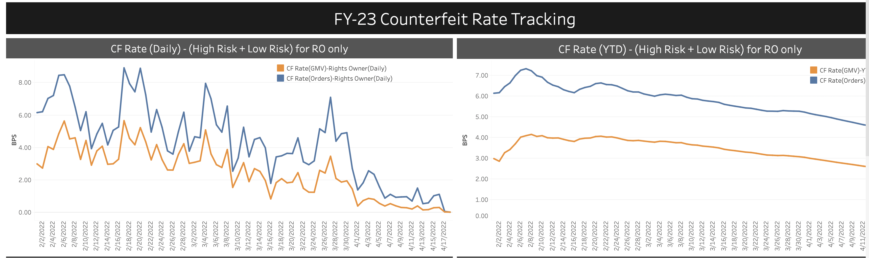
CF Rate Tracking

Slide 10
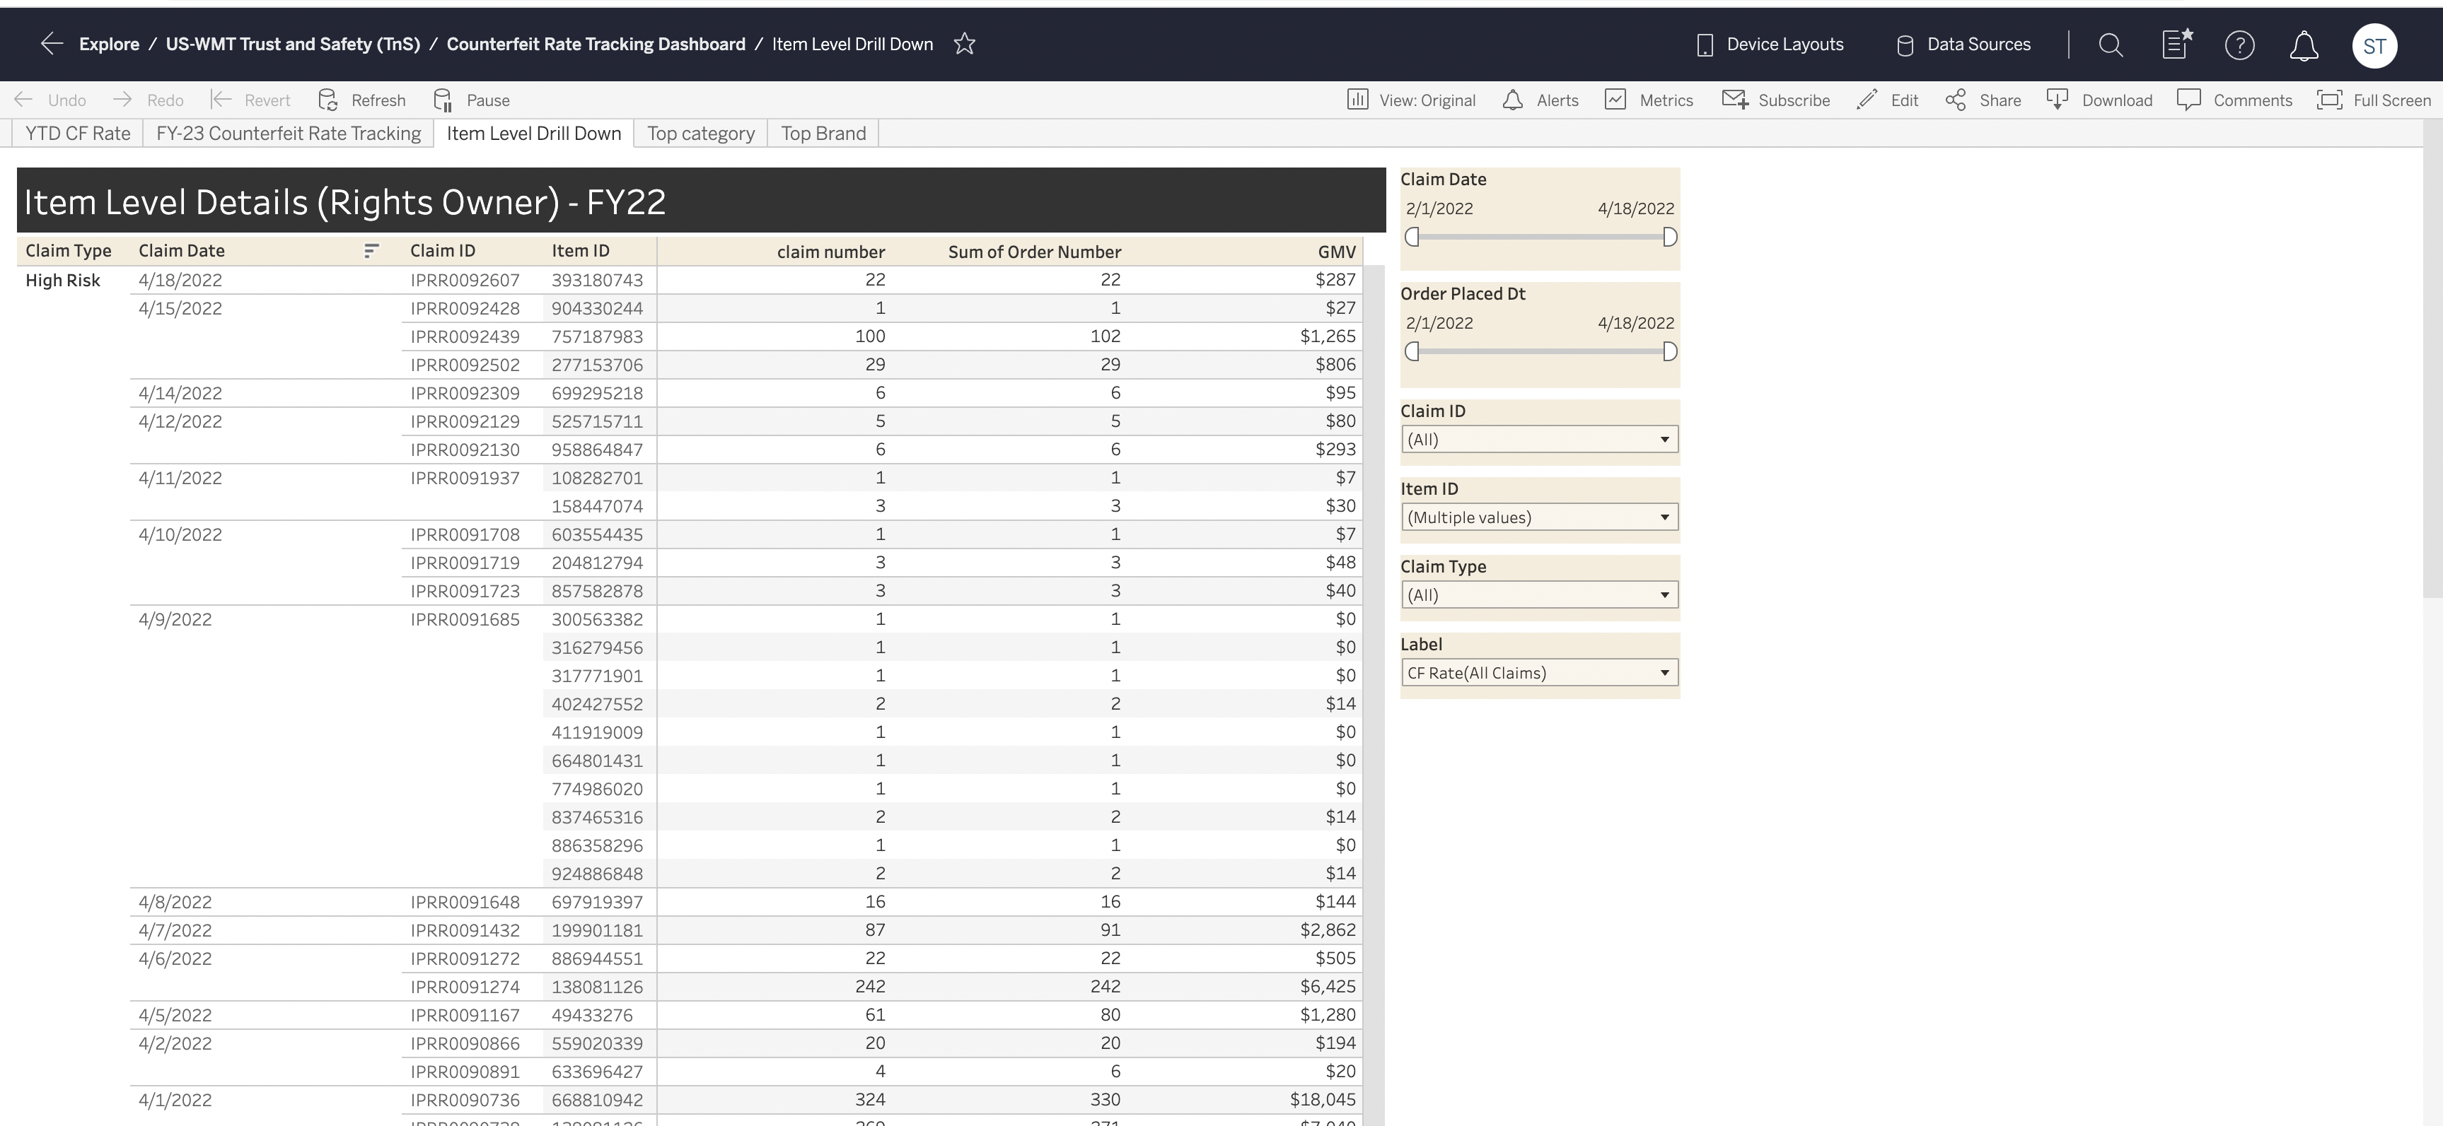
Item Level Detail

Slide 11
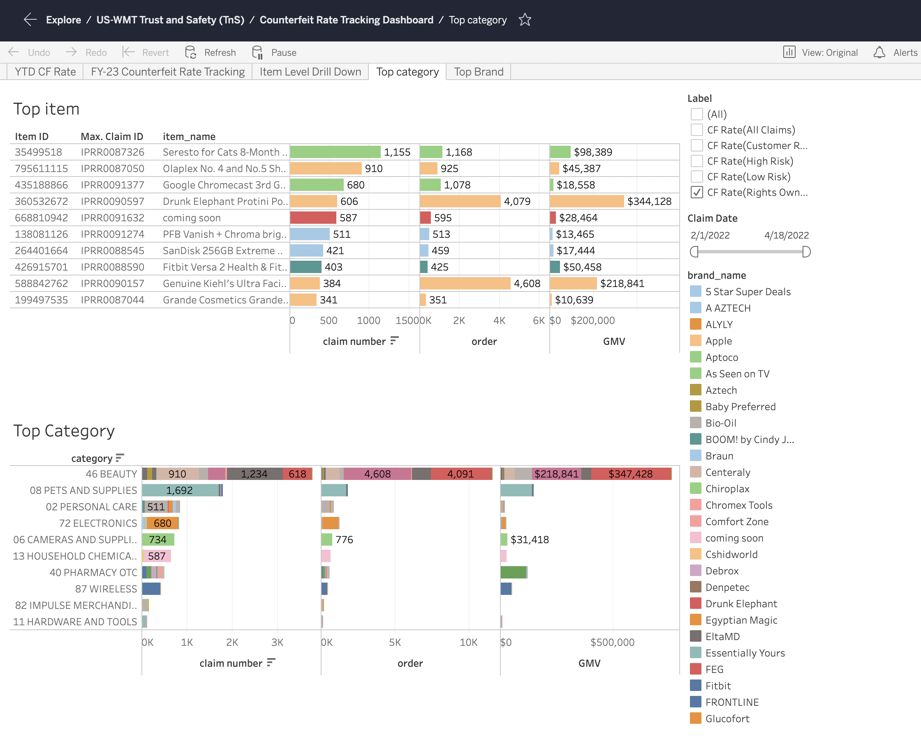
Category Level Detail

Slide 12
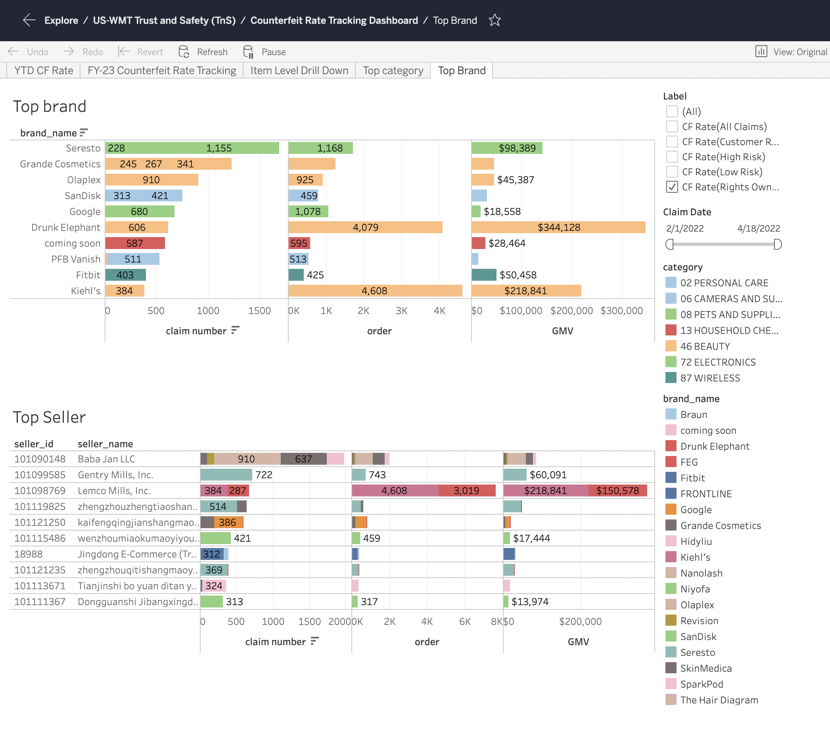
Brand Level Detail

Slide 13
Thankyou!!

